Slide 1
FedOps: FL Lifecycle Operations Management Platform
KangYoon Lee & SeMo Yang
Cognitive Computing Lab
in Gachon University
Notes:
Thank you for providing us with this opportunity to introduce FedOps.
I am KangYoon Lee, a professor from the Cognitive Computing Lab at Gachon University in Korea.
Today, I’m thrilled to introduce FedOps platform for FL lifecycle operations management.
20초

Slide 2
Agenda
What is FedOps?
FedOps Simulation on Cloud
FedOps on Real Device
DEMO
Conclusion
Notes:
I will proceed with the presentation in order.
First, introduction to us,
How did FedOps come about? what is FedOps?
FedOps Simulation in the cloud environment and FedOps service that can apply FL to real devices,
Finally Conclusion
30초

Slide 3
What is FedOps?
FedOps: Federated Learning Lifecycle Operations Management
Motivation
Need a platform that can manage FL operations by extending the concept of MLOps
Q1. How can AI/ML Project be easily applied to FL?
Q2. How to deploy and run numerous clients in FL environment like MLOps?
Q3. How can we manage the client/server lifecycle for FL operations?
FL Operations
Existing MLOps
Experiment Tracking
Model Build
Data
Collection
Data
Labeling
Data
Versioning
Baseline Model
Model Evaluation
Model Train
FL Server
FL Clients
Global Model
Local Models
Local Model
Weights Aggregation
Global Model
Update
Data Processing &
Local Model Train
Clients
Participation
Global Model Build/
Evaluation
FL Request
Local Model
Evaluation
Global Model
Versioning
Local Model
Weights
Local Model
Versioning
Management & Monitoring
FL Clients
FL Server
Model Performance
FedOps Overview
3
Notes:
We developed FedOps to address the lack of practical research in operating and managing FL in real-world projects.
FL algorithms and frameworks show promise in enhancing performance,
but an effective FL operations platform is required.
To provide a solution, we focused on three key questions:
First, easy application of AI/ML in FL,
Second, deployment and execution of data/models in multiple clients,
Third, managing the FL lifecycle in real-world scenarios.
In the overview of FedOps,
we extended the existing MLOps to facilitate the application of FL to ML projects.
The Baseline Model, created through MLOps, is deployed and executed to multiple clients
that configured to perform FL by connecting to the server.
The Local/Global Model is continuously version-managed.
To manage and monitor the FL lifecycle, FedOps enables the tracking of logs from both the Client and Server,
ensuring smooth operations.

Slide 4


What is FedOps?
FedOps Architecture
FL Client
Local Weights
FL Server
1. FLScalize on Flower
New Global Model
Training
Save
Save
Data
Local Model
Global Model
2. Manager
Client Manager
Condition
Server Manager
3. CE/CS BCFL
Client Performance
Performance/Incentive
CE/CS/BCFL
4. CI/CD/CFL
Continuous Integration/Deployment
Code Repo
Continuous
Federated Learning
Flower Core
Poll
Poll
Manager
CE/CS/BCFL
5. Monitoring
Client Monitoring
Server Monitoring
Opensource
Data/Model/Code
FL Researcher
4
Notes:
FedOps has five key features:
FLScalize: It simplifies the application of data and models in a FL environment by leveraging Flower's Client and Server.
Second, the manager oversees and manages the real-time FL progress of both clients and server
Third, Contribution Evaluation and Client Selection processes incentivize individual clients through a BCFL based on their performance.
Fourth, the CI/CD/CFL system integrates with a Code Repo,
enabling code deployment to multiple clients and servers for continuous or periodic federated learning
Fifth, the FL dashboard is available for monitoring and observing the lifecycle of FL clients and server

Slide 5
What is FedOps?
FL Framework Competitive Analysis
 | TFF | FATE | FedScale | EasyFL | FedML | FedOps
1. Simple application of data and model | ✓ | ✓ | ✓ | ○ | ✓ | ○
2. FL client/server management | X | X | X | X | X | ○
3. Heterogeneous system and data (without BCFL) | ✓ | ✓ | ✓ | ○ | ○ | ○
4. Multi-client CI/CD/CFL | X | ✓ | X | X | ✓ | ○
5. FL lifecycle management | X | ✓ | X | ✓ | ✓ | ○
✓: Limited support
5
Notes:
We have summarized the distinctive features of FedOps by conducting practical tests on various FL frameworks.
FedOps allows users to easily apply their own data and models without caring about FL.
FedOps has Manager Components that continuously manages the status of Client and Server.
Only FedOps has this feature.
FedOps supports both System and Data Heterogeneity Simulation capabilities.
And, provides CI/CD/CFL functionality to Multi Client.
So, FedOps can manage the lifecycle of FL clients and server with these functions.

Slide 6


FedOps on Real Device
Client(Docker & Shell )
Server(Microk8s Env)
Client Monitoring
Client Performance Pod
Health of Data
&
Local Model Performance
Check
Client/Server Status
Client Manager
Server Manager Pod
Client Status
Local Model Performance
Evaluation
Data
Start
Info
Global
Model
Data
Local Model
Train
Trigger
Save
Evaluation
Save
FL Client
Connect
FL Server Pod
Register FL Task ID
Deploy & Run
Global Model
Performance/
Versioning
Web Service
Create/Manage
FL Task
Select Clients
Run FL Task
Manage/Download Global Model
Performance
Monitoring
6
Notes:
And, we developed a FedOps web service to manage the lifecycle operations of FL on real devices.
Users can create FL tasks and register task ID in the clients.
Once the user select the clients that participate in the FL round, the user can run FL task and that deploys FL server.
As FL is performed, the user monitors local and global model performances and manage/download global model through the web interface.
At the client level, the clients can monitor own data status and performance with WandB or ELK.

Slide 7
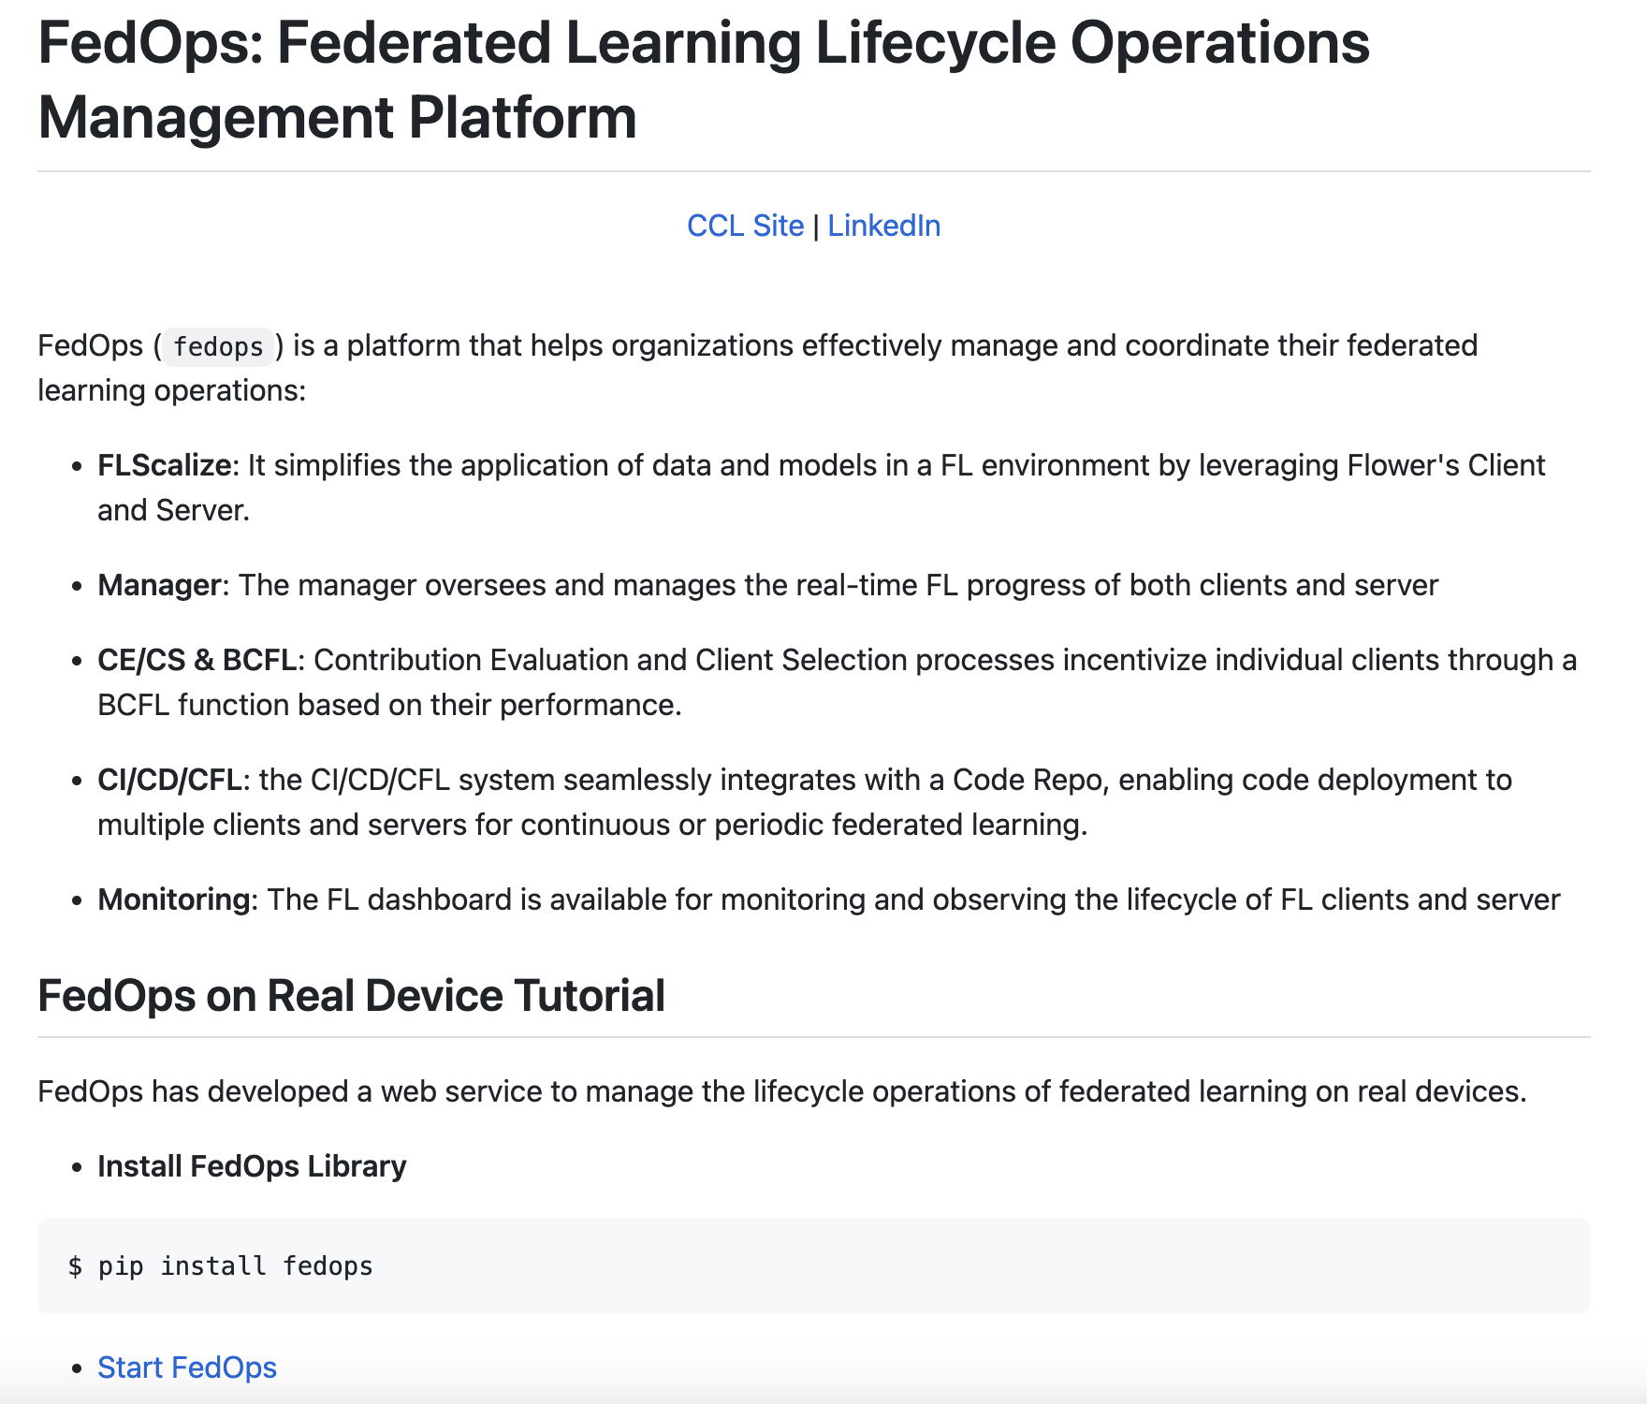
FedOps on Real Device
Installation FedOps
pip install fedops
FedOps Github Repository:
https://github.com/gachon-CCLab/FedOps
7
Notes:
We have open-sourced FedOps and it can be easily installed from pip.
The guide includes the Git repository address and instructions for managing the lifecycle of your FL tasks.
While the web service for FedOps is currently unavailable, it will be deployed in the near future,
allowing you to utilize our FedOps platform for your Federated Learning operations.

Slide 8
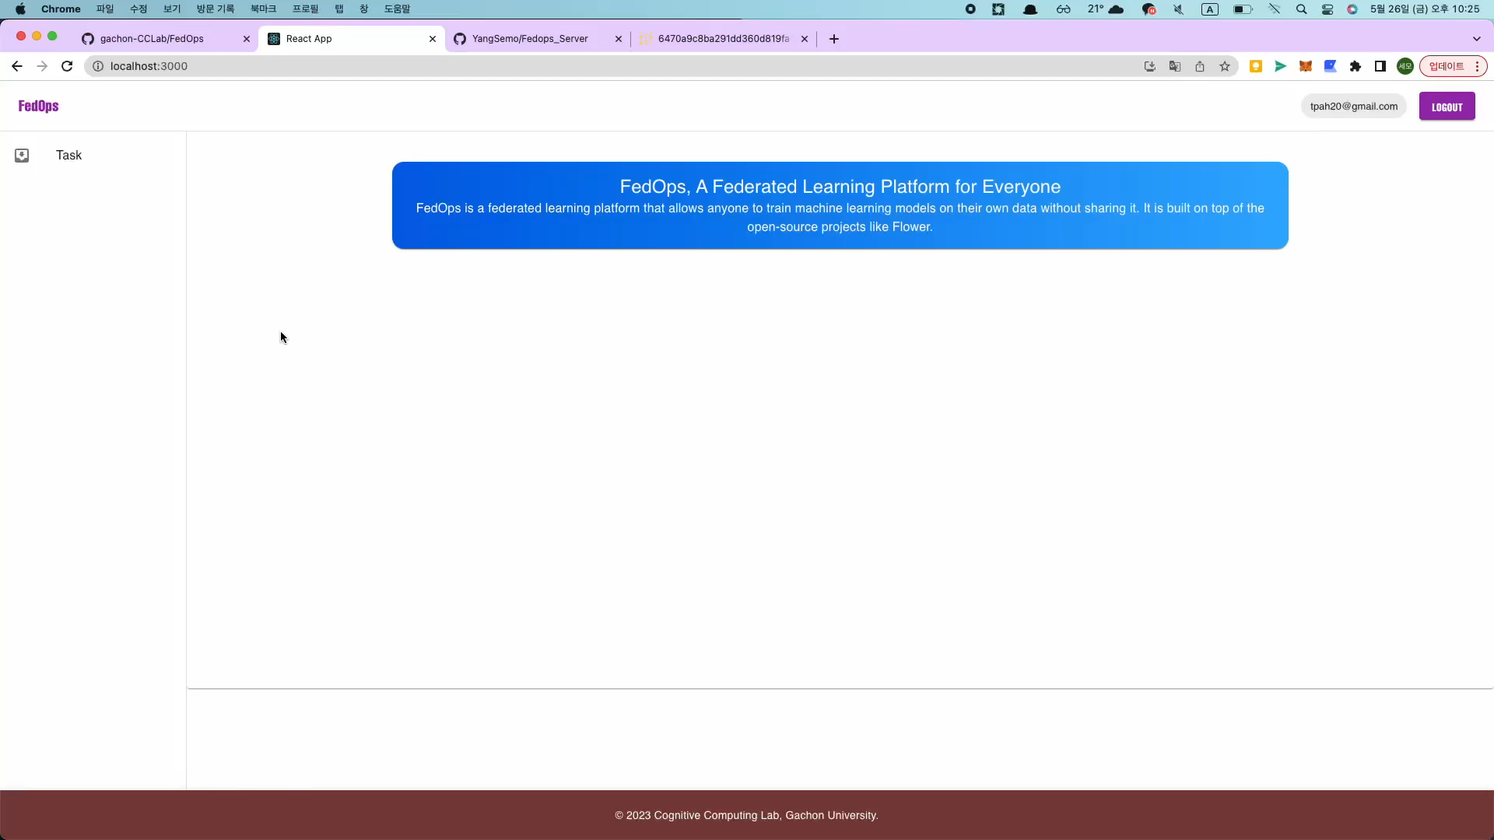
FedOps on Real Device
DEMO
FedOps Git: https://github.com/gachon-CCLab/FedOps.git
8
Notes:
I will demonstrate a FedOps Demo that showcases the management of FL lifecycle using a real device.
To get started, create your FL Task in the FedOps web interface. Enter the title, description, and tags for your Task. Additionally, provide the address of the FL server Git repository that you have created. Once registered, it is not cumbersome to upload the code file to the web because you can separately manage the FL server code only in Git. This will allow the FL server to be deployed and run in our server environment.
Once your FL Task is created, it will be assigned a unique task ID. In order to register a client in this FL task, the client’s config file needs to be updated with the assigned task ID and the user's WandB information for client monitoring. And run the client and client manager. In this way, the client is registered in the FL task.
After selecting the client, click the "FL Start" button. This deploy and execute the FL server code that you previously set up in the server repository. The FL server creates FL rounds for task. The client proceeds with training as much as the round set in the server.
FedOps provides lifecycle management for FL tasks. You can monitor the performance of the global/local models and track the client's system resource usage based on the model version. Additionally, you can save and manage the global models according to different versions.
To monitor the performance of the client's local model and the status of the client's data, you can check the information using the WandB that you set up earlier.
This demo specifically demonstrates the training of a TensorFlow-based CNN model using the CIFAR-10 dataset.
If you configures the data loader to import data in real-time,
there are advantages that enable continuous Federated Learning without worrying about client/server interactions.

Slide 9
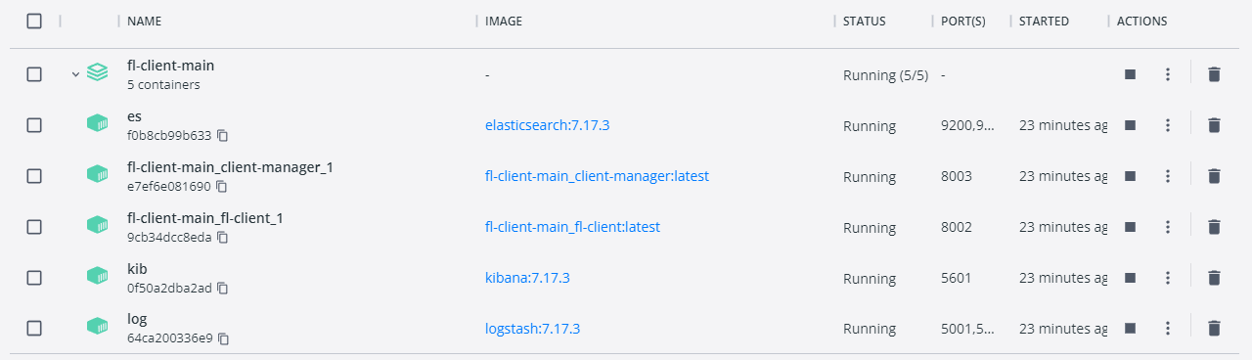
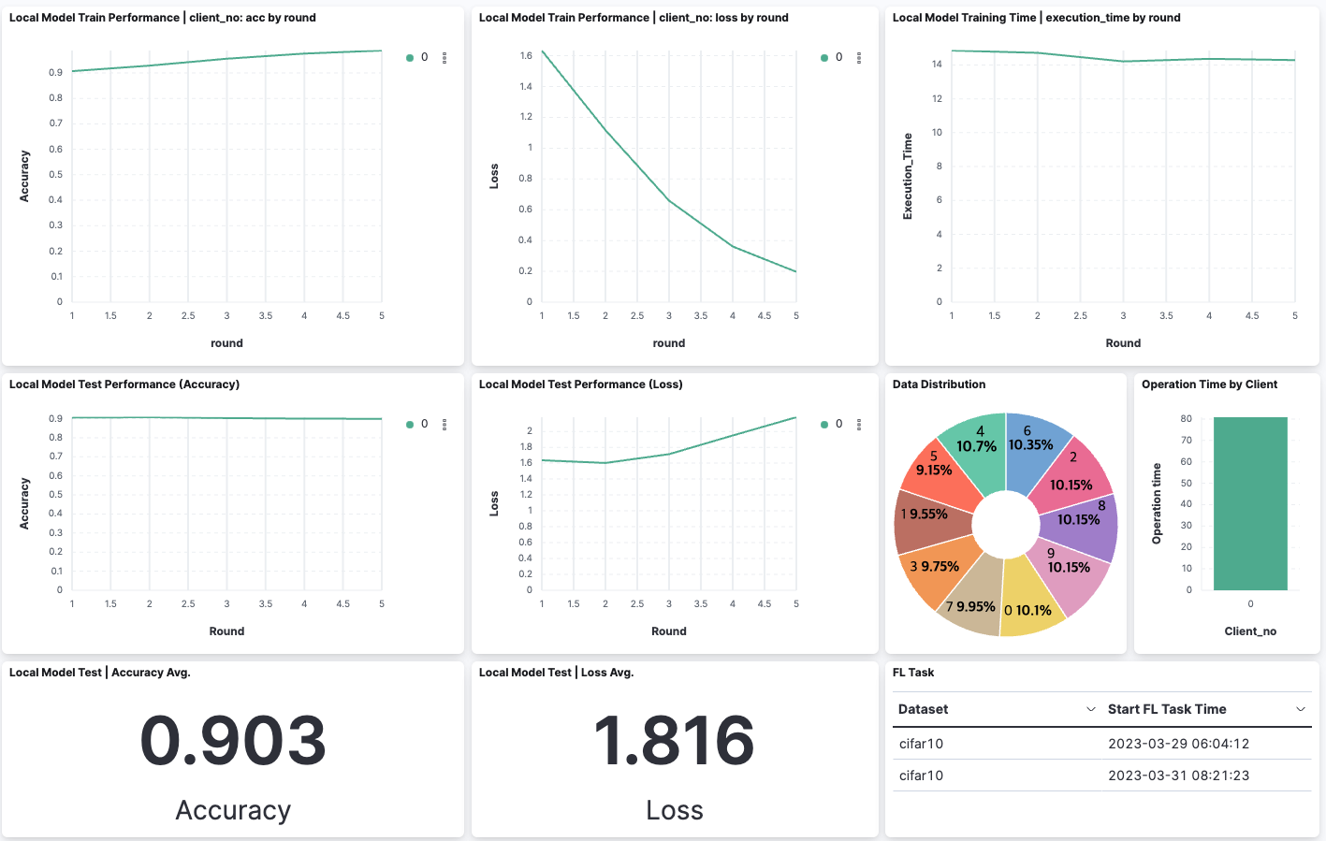
FedOps on Real Device
Local Model
Train Data Accuracy
Local Model
Train Data Loss
Local Model
Training Time per round
Local Model
Test Data Accuracy
Local Model
Test Data Loss
Own Data Distribution &
FL Running Time of Client
FL Task Records
Docker-based FL Deployment to Real Devices
Monitoring the health of data, local model performance, and time cost on your Device for each FL task by using ELK
9
Notes:
The FedOps also supports a docker-based client environment.
Clients can monitor their data and performance through the ELK stack.

Slide 10
Conclusion
FL Lifecycle Operations Management for Various FL Tasks
: Efficiently manage FL tasks throughout their lifecycle.
FL Simulation for Real-World Heterogeneity
: Simulate FL with diverse data and systems, mirroring real-world scenarios.
Web Service-Enabled FedOps Platform
: Empower FL management on real devices through a dynamic web service.
Future Work:
Deliver seamless support for mobile devices(Android/iOS).
Incentivized BCFL to drive participant performance and foster active engagement.
Leveraging FedOps for Decentralized Clinical Trials & Distributed Telemedicine.
10
Notes:
To conclude, our FedOps ensures efficient management of FL tasks from start to finish.
FedOps FL Simulation replicates real-world scenarios by incorporating diverse data and systems.
Lastly, Web Service-Enabled FedOps Platform empowers FL management on real devices.
In our future work, we have several goals:
We plan to support mobile devices, expanding the reach of our platform.
We want to incentivize participants in Federated Learning to drive performance and engagement.
We will leverage the power of FedOps for Decentralized Clinical Trials & Distributed Telemedicine By achieving these goals, we aim to enhance the reliability, accessibility, and effectiveness of our platform.

Slide 11
FedOps Article
IEEE Access
FLScalize: Federated Learning Lifecycle Management Platform
FLScalize to enable AI researchers to conveniently apply their own custom data and models to FL environments that can occur in the real world and to deploy and manage the FL lifecycle
Published (2023.05.11), https://ieeexplore.ieee.org/document/10122960
FedOps: MLOps-Based Platform of Federated Learning Services with Heterogeneity Management
The FedOps Platform provides a systems heterogeneity analysis tool called chunk-bench that gains valuable insights into device heterogeneity and communication cost by using only a small chunk of the client’s data
(Review in progress)
Article based on Flower
Federated Learning-Based Privacy-Preserving Personal Identification Using Non-Contact Radar Signals
(Review in progress)
11
Notes:
So, we wrote two papers about FedOps,
FLScalize has recently been published in the IEEE Access journal
The paper provides a detailed and comprehensive description of FedOps.
And, we conducted an analysis on System Heterogeneity and authored a thesis on CE/CS, which is currently under review.
Also, We wrote an article on privacy-preserving personal identification using Federated Learning and non-contact radar signals with the FLOWER framework.

Slide 12
CCL page: https://sites.google.com/view/keylee
KangYoon:
- keylee@gachon.ac.kr
- https://www.linkedin.com/in/ebizky/
SeMo:
- tpah20@gachon.ac.kr
- https://www.linkedin.com/in/semoyang/

